Slide 1
welcome
Inter-Related cooperative education
Notes:
Review slideshow and read side notes at the bottom of each slide.

Slide 2
What is Cooperative education?
Cooperative Education (commonly known as a “Co-Op“), is a structured method of combining classroom-based education with practical work experience.
Notes:
Co-Op Class meets every day during 6A/B. Students will leave after 6B and go to their jobsite.

Slide 3
Why Cooperative education?
Soft Skills
in the classroom
Technical Skills
at the job site
Character Traits, Attitudes and Interpersonal Skills such as…
Human Relation Skills
Self Confidence
Motivation & Goals
Emotional Intelligence
Values & Ethics
Communication Skills
Leadership Skills
Matching your skills to those required by the employer such as…
Analysis
Application
Assembly
Design
Operation
Troubleshooting
Notes:
According to research employers value soft skills as much or more than technical skills in the workplace. Employers can train employees in technical skills, but they struggle with the employees who can’t work efficiently due to lack of communication skills, self confidence, etc. Gain the soft skills in the classroom and learn how to apply them in the workplace, as well as gain technical skills in your career field of interest.

Slide 4
Cooperative education classroom Curriculum
Notes:
Again…getting hired is more than performing the technical skills on the job. It is about showcasing your soft skills (see soft skill list) and how you will work and fit into that business’s culture. The Co-Op Class will cover several units (see semester 1 and semester 2 listings).

Slide 5
Cooperative education Previous job site employers
Career Clusters | Employer | Employer | Employer
Arts | Peoria Camera Shop
Architecture & Construction | Designs Plus
Finance | Better Banks
Hospitality & Tourism | The Fish House | Texas Roadhouse
Health Science | OSF | CVS Pharmacy
Human Services | Apple Tree Learning Academy | Rogy’s Child Care | Learning Connections
Law, Public Safety, Corrections and Security | Bartonville Fire Dept.
Marketing, Sales and Services | Goodwill Industries | Dixon’s Seafood | JCPenney
Manufacturing | Philippi-Hagenbuch | Morton Industries | Caterpillar
Transportation | Dennison Chevy
Notes:
There are many employers throughout the career clusters (see above). New employers and career clusters get added every year. Students will be placed according to their career field of interest and will be expected to remain at that job site unless approved by Mrs. Belsly.

Slide 6
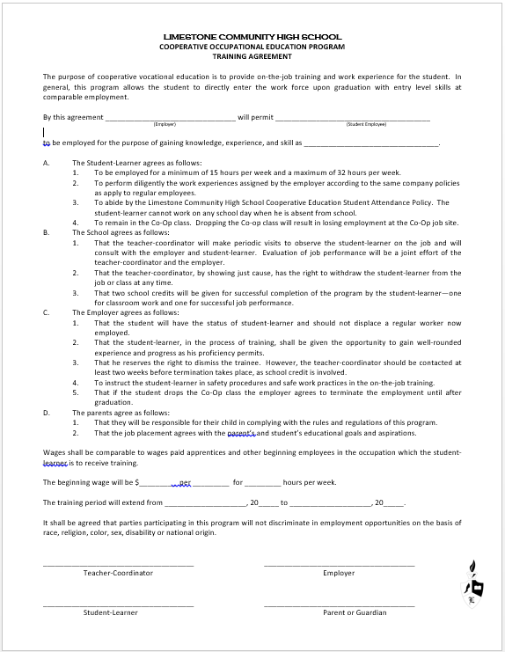
Training agreement form
The Student-Learner
15-32 hours per week (will fluctuate during seasons)
Company policies must be followed and supervisor is in charge
Students cannot work if absent at school (10 max)
Students must be enrolled in the Co-Op class
B. The School
1. Two formal observations per semester with focus on
supervisor’s evaluations
2. Co-Op instructor can withdraw student from job site
3. Classroom=1 credit /Jobsite = 1 credit for year
C. The Employer
1. Student should not replace regular worker
2. Gain technical experience
3. Employer can dismiss student and could effect Co-
Op class status
4. Proper training
5. Dropping Co-Op will result in job site termination
D. The Parents
1. Enforcing rules and policies (jobsite and classroom)
2. Students place in career of interest and/or
acceptable jobsite for other reasons
Wages have been agreed upon
Training period has been designated and students can’t just quit or switch without Co-Op instructor’s permission
Notes:
Students will work a minimum of 15 hours. Co-Op is not meant to serve as means to pay personal bills such as a car loan. Students must be enrolled in both the Co-Op Class in order to work at the job site. Observations will take place in both the classroom and the jobsite. Co-Op jobs are paid but can vary due to age and experience.

Slide 7
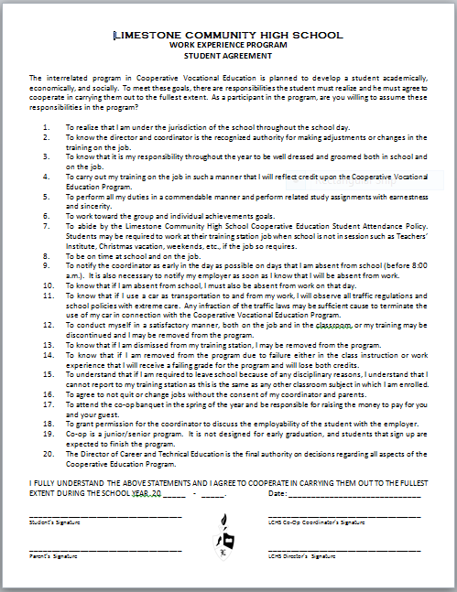
Student Agreement Form
LCHS policy.
Co-Op Instructor Mrs. Kitty Belsly and Assistant Principal Mr. Charlie Zimmerman
Personal hygiene is expected.
Accountability
Professionalism
Teamwork
Accountability and Professionalism
Punctuality
Accountability and Professionalism
Accountability and Professionalism
Citizenship
Accountability and Professionalism
Accountability
Accountability
Accountability
Accountability and Professionalism
Accountability and Teamwork
Professionalism
Accountability
Assistant Principal Mr. Charlie Zimmerman
Notes:
Professionalism and accountability are expected on all levels both in the classroom and on the jobsite.

Slide 8
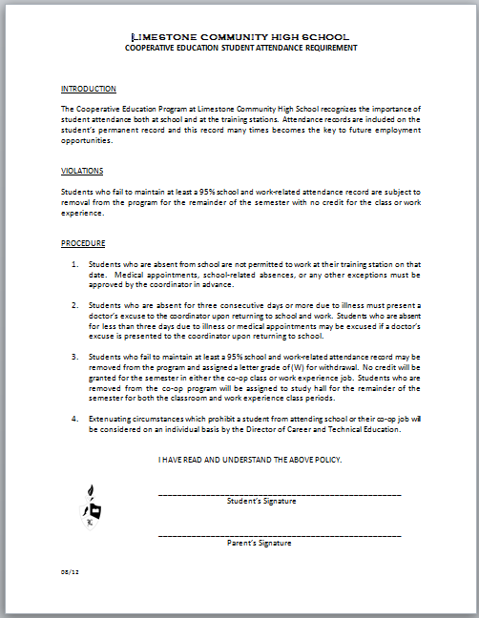
Student attendance form
Students MUST maintain a 95% attendance record during the 2017-2018 school year. Therefore, students cannot miss more than 10 school days/class before being removed from the Co-Op Program.
Exceptions to the policy with teacher discretion are:
School related business
Notes:
Students must have a 95% attendance rate their senior year (10 absences max).

Slide 9
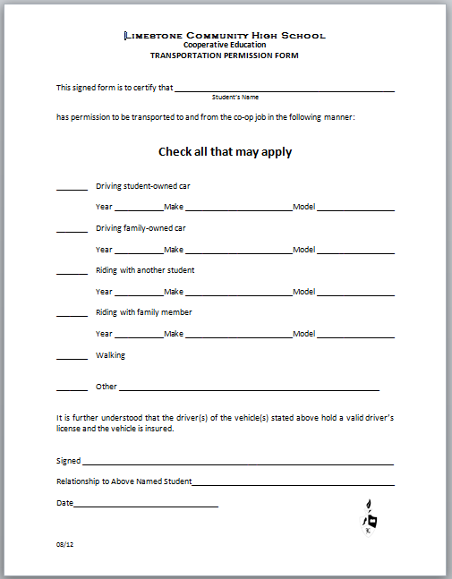
Transportation form
Students are expected to provide their own form of transportation, follow all traffic laws, and be punctual to work.
Notes:
Students must provide their own form of transportation to and from work regardless if the student loses driving privileges, loss of license, etc.

Slide 10
Cooperative education grading scale/Credits
CATEGORY | PERCENTAGE
Assignments | 20%
Quizzes | 20%
Projects | 20% 1 credit
Term Assessments | 20%
Classroom (Co-Op Instructor) Evaluations | 20%
Job Site (Employer) Evaluations | 100% 1 credit
Notes:
Co-Op students will receive 2 credits (1 for classroom and 1 for jobsite)

Slide 11
Co-Op Student/Parent Meeting
Mandatory meeting for all potential 2017-2018 Co-Op candidates and parents in MAY 2nd.
Notes:
Students and parents must attend the Co-Op meeting in order to be officially registered for the 2017-2018 school year.

Slide 12
Co-Op Registration Procedure
Go to http://www.limestone.k12.il.us
Click Academics
Click Family and Consumer Science
Click Mrs. Belsly’s website link
Click Co-Op
Click Co-Op Application PDF
TYPE and PRINT and submit with your Wish List Form to your Guidance Counselor
Interview will be scheduled by Mrs. Belsly after application is submitted and approved by your Guidance Counselor
Notes:
Guidance counselors must receive application first before interviews will be scheduled.

